Slide 1
Production of Short-lived Radionuclides in Asymmetric Supernovae
Charlotte K. Johnson
Dr. Patrick Young
Department of Physics, School of Earth and Space Exploration
Arizona State University

Slide 2
Purpose
Computational models provide:
  Guidance for observational data collection
  A resource for interpreting observational data
  Simulated information that cannot be recreated experimentally on Earth
Provide insight into the history of our own solar system
  Ratios of short-lived radionuclides (SLRs)
  Heat source for differentiation

Slide 3
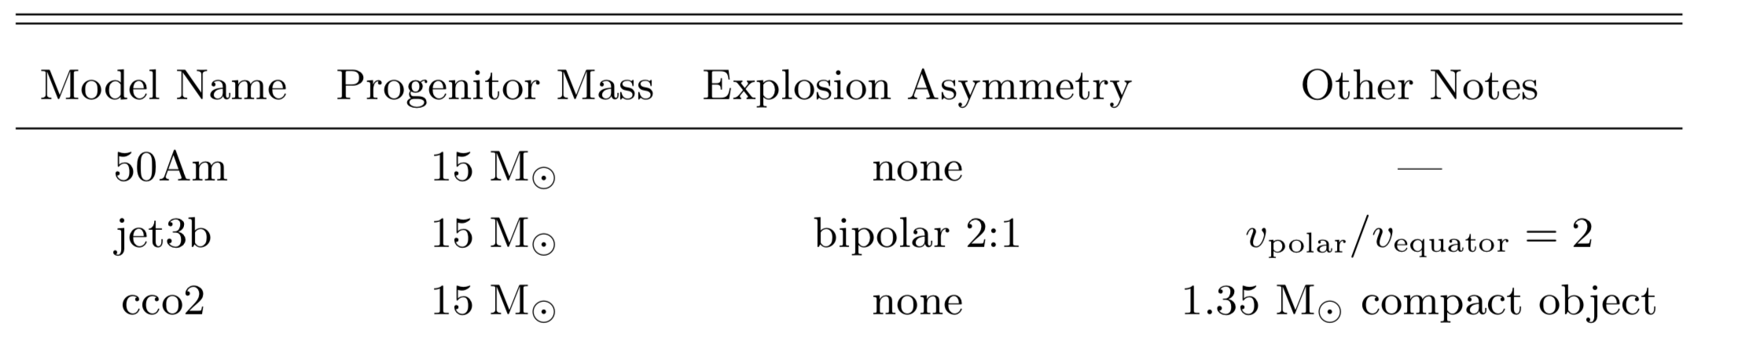
Three supernova simulations

Slide 4
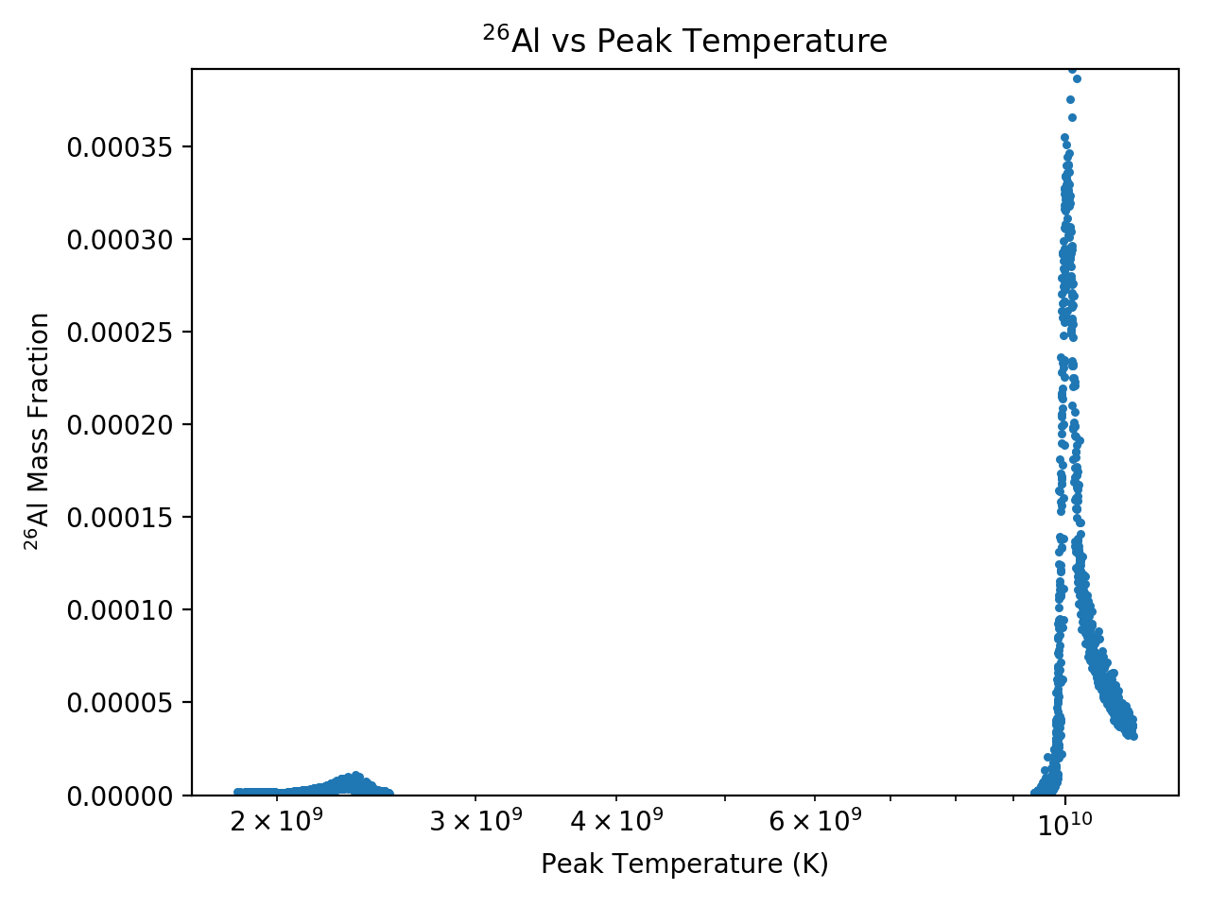
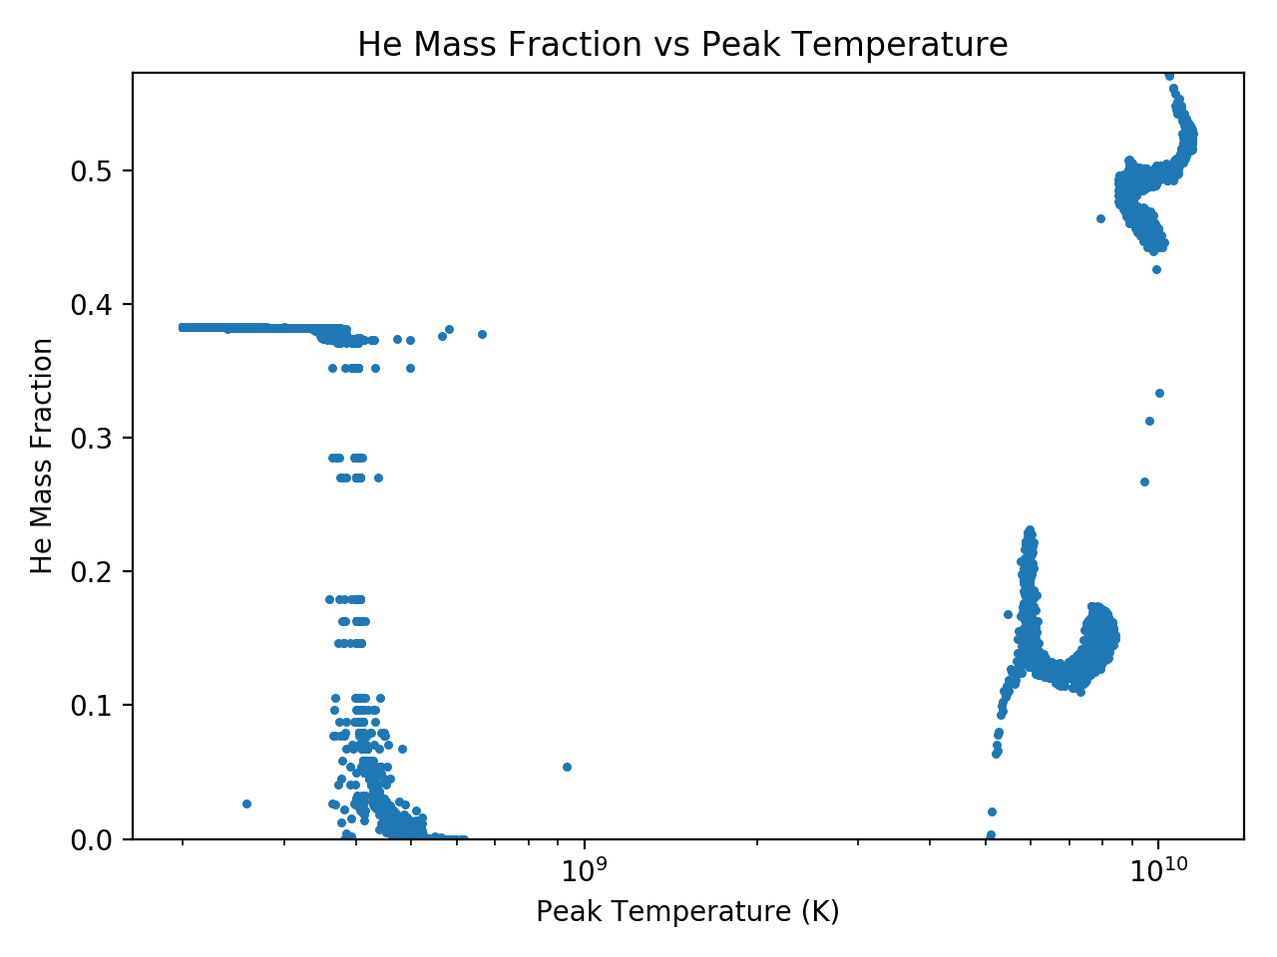

$α$-rich freezeout
jet3b
jet3b

Slide 5
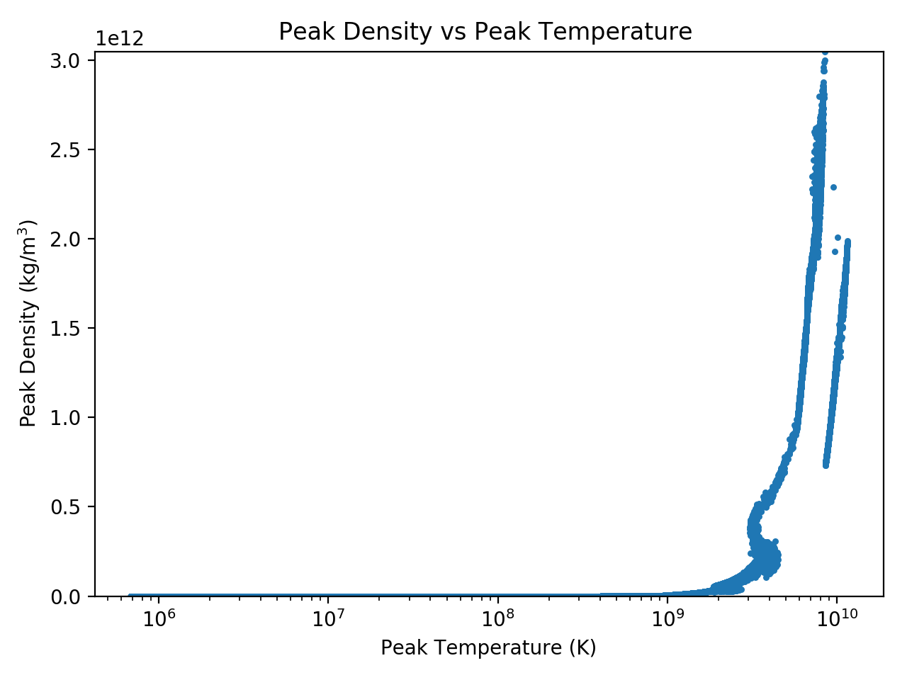
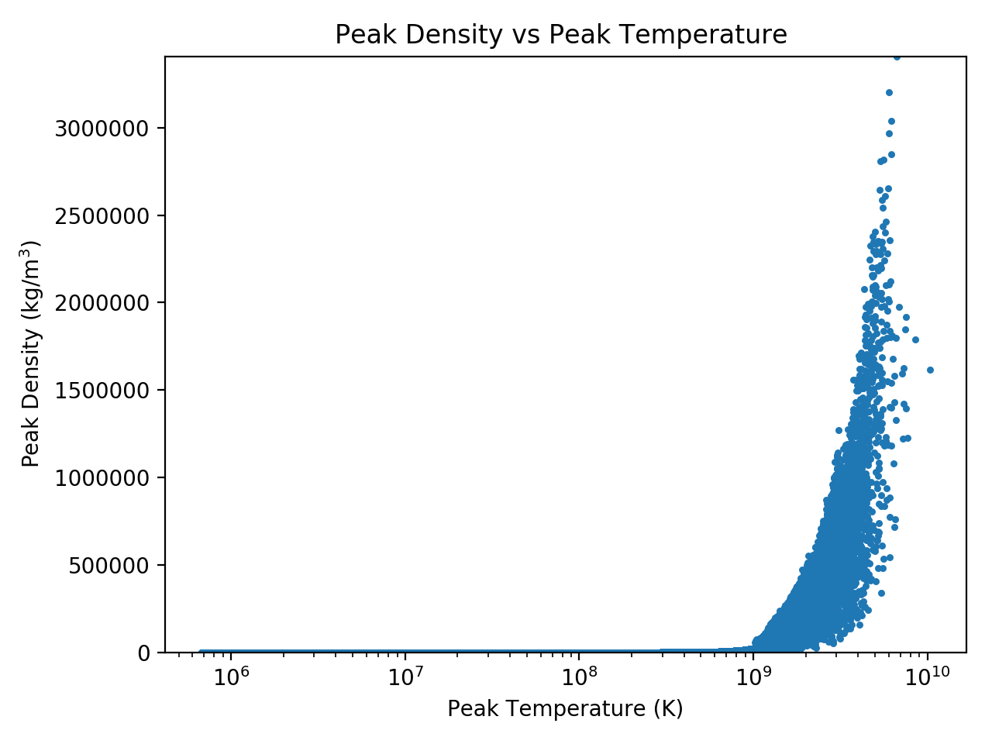
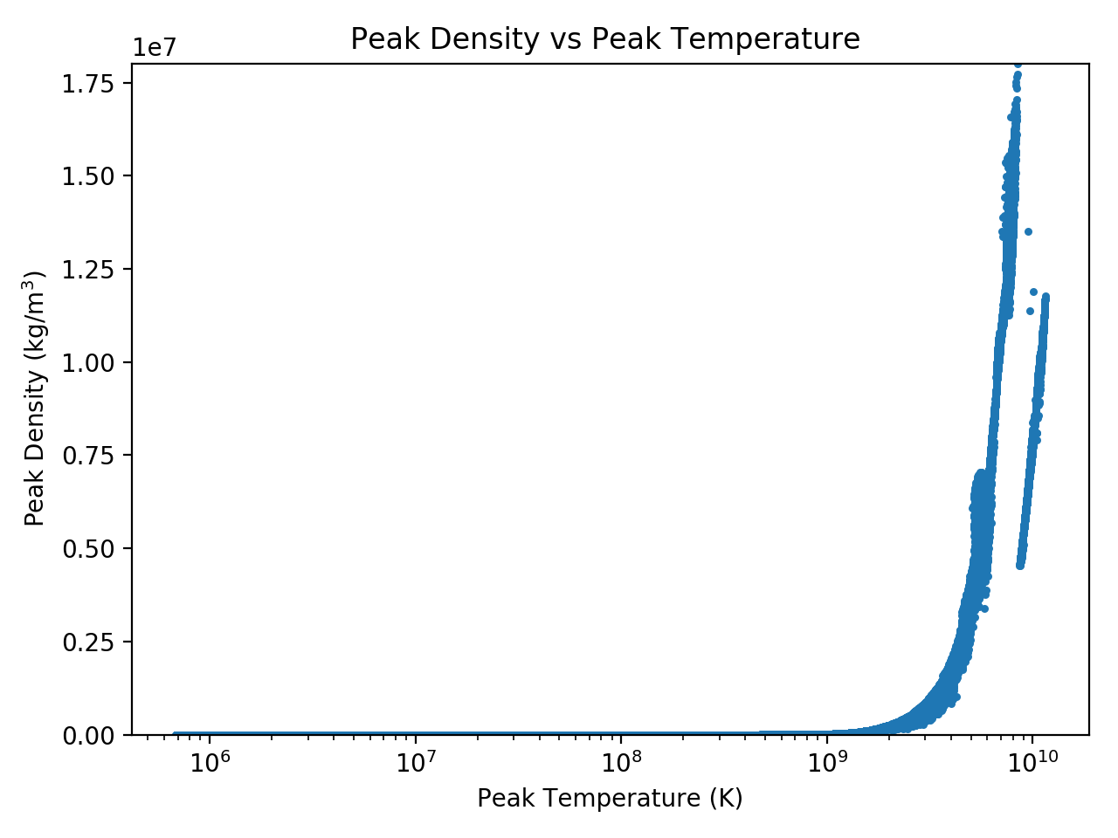
Comparison of peak densities against peak temperatures
jet3b
cco2
50Am

Slide 6
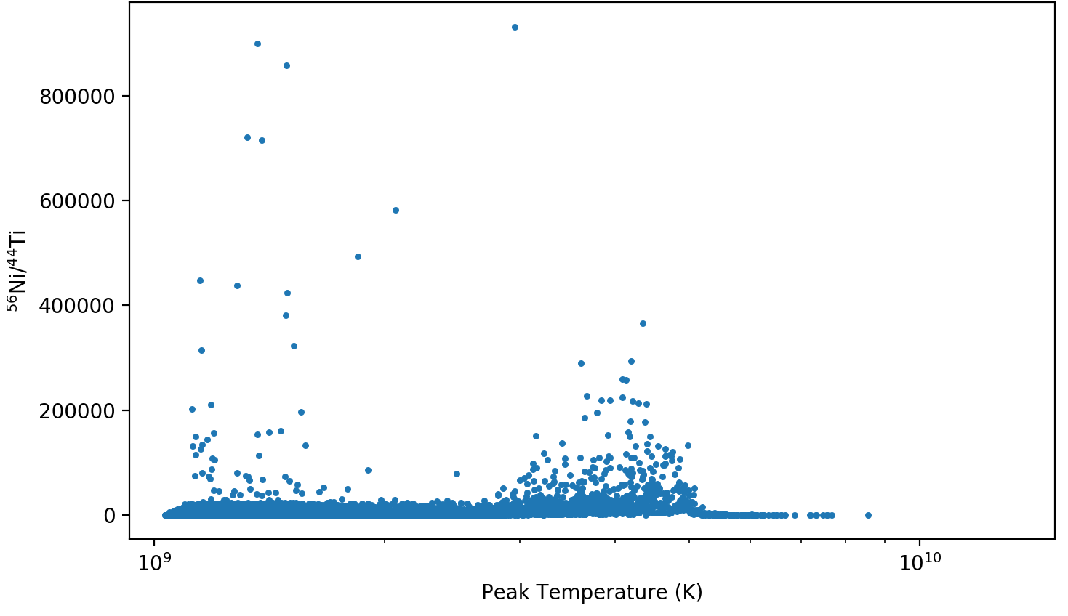
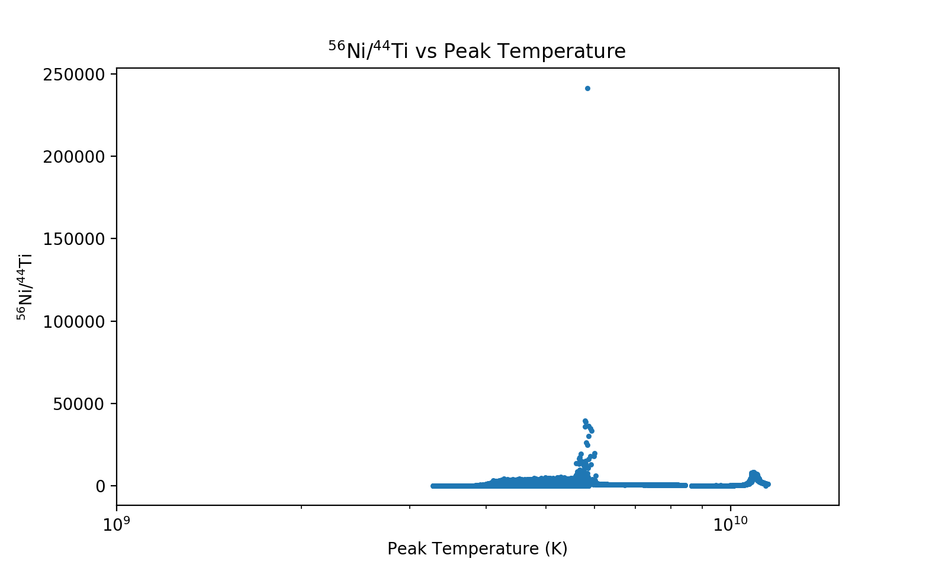
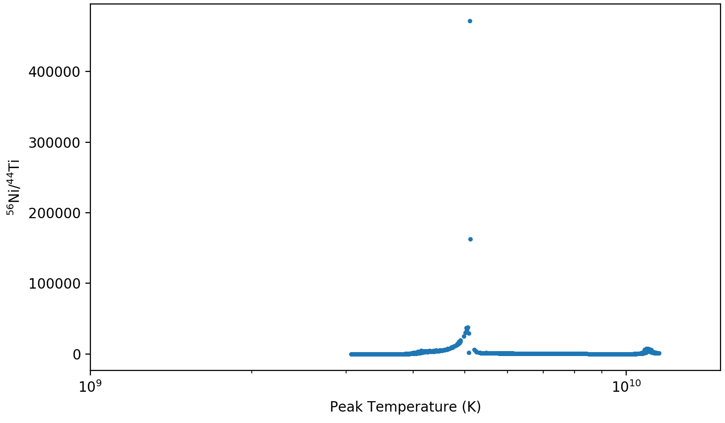
Ratio of ⁵⁶Ni to ⁴⁴Ti
Particularly sensitive to changes in peak temperature and density
Cassiopeia A emission lines
cco2
50Am
jet3b

Slide 7
Future Work
Comparison to observational data
More models
More SLR comparisons (⁴¹Ca, ⁶⁰Fe, etc.)

Slide 8
Thank you!
Special thanks to the ASU/NASA Space Grant Program, Dr. Patrick Young, and Greg Vance

Slide 9
Questions?

